Slide 1
Spring Chinook Salmon in the Portland Metro Area
Jenny Kaylor, Josh Williams, Jay Hastings, Erica , and Courtney Muhlbach

Slide 2
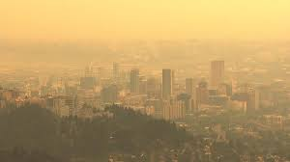
Hypothesis
Does pollution have an affect on the salmon population?

Slide 3
Goal
Our goal is to understand the “2005-2019” water’s effecy on the Native Chinook Salmon Populations in he “Lower Columbia” area during their migration cycle to spawn in the “Spring”.

Slide 4
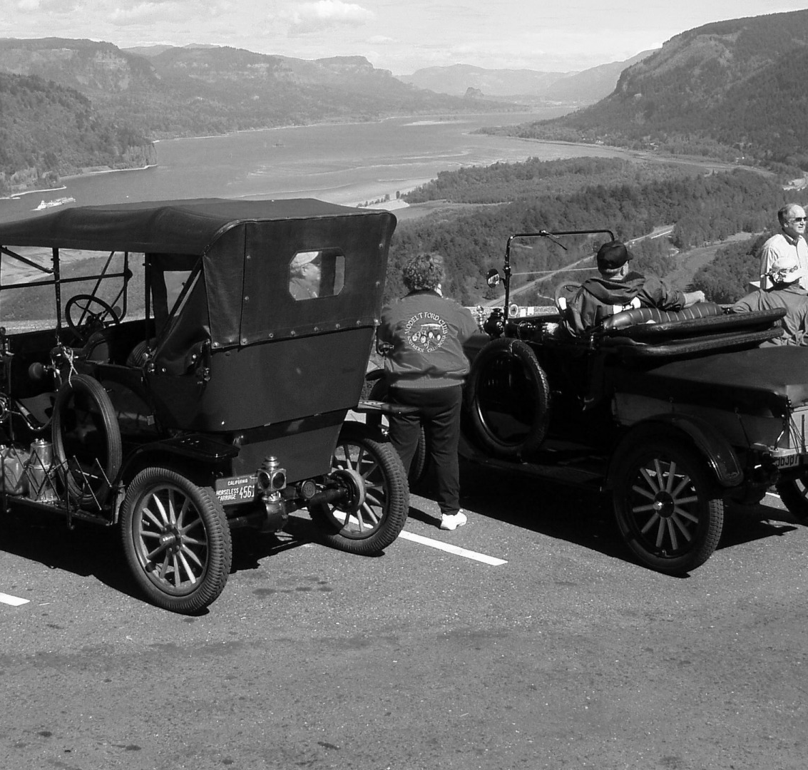
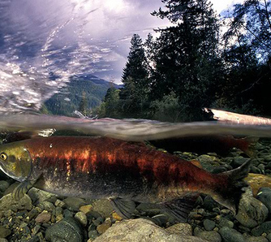
Background
Salmon
Rivers
Cities
Dams
Oh My!

Slide 5
Proposal
Target whether this has been effective
What are the ideal water conditions for catching salmon

Slide 6
Questions Asked
Will Spring Chinook Salmon be here for our grandchildren?
What data do we have?

Slide 7

Data Clean up and Exploration
Google misery
Too many sources – is it relevant data?
Data inconsistencies – so many formats
Making sure our shapes matched up – working with teams
Scrubbing, Scrubbing, Scrubbing

Slide 8
Data Analysis

Slide 9
Discussion

Slide 10
Post Mortem

